Slide 1

Ruchitha K M 4VP24MC041
Secure AI Model Deployment Using Confidential Computing
Prof. Neema H
Assistant Professor

Slide 2
Contents
Introduction
Objectives
Literature review
Applications
Methodology
Conclusion
Dept of MCA, VCET, Puttur.

Slide 3
Introduction
Secure deployment of AI models is essential as they often handle sensitive data such as personal, financial or medical information. Traditional security methods protect data during storage and transmission but leave it vulnerable during processing.
Confidential computing addresses this issue by using secure hardware environments called Trusted Execution Environments (TEEs), which keep data and AI models protected even while they are being processed. This ensures privacy, prevents unauthorized access, and safeguards valuable models.
Dept of MCA, VCET, Puttur.

Slide 4
Introduction
In addition, confidential computing helps organizations meet data protection regulations and maintain user trust. By ensuring that sensitive information is never exposed during computation, it reduces the risk of data leaks and misuse.
This approach enables secure and reliable AI deployment, allowing businesses to use advanced technologies while maintaining strong security and privacy standards.
Dept of MCA, VCET, Puttur.

Slide 5
Objectives
To ensure the protection of sensitive data during AI model execution using confidential computing techniques.
To safeguard AI models from unauthorized access, theft, and tampering.
To implement Trusted Execution Environments (TEEs) for secure processing of data and models.
To enhance privacy, trust, and compliance with data security regulations in AI systems.
Dept of MCA, VCET, Puttur.

Slide 6
Literature Review
Title | Author | Description
Secure AI Inference in the Cloud: Enabling Confidential Computing with Trusted Execution[1]. | Pawan Negi Uttari et al [2025] | This paper explains how confidential computing can secure AI models in the cloud using Trusted Execution Environments (TEEs). It protects data and models during processing, ensuring privacy and safe AI deployment.
Confidential Computing for Cloud Security: Exploring Hardware-Based Encryption Using TEEs[2]. | Dhruv Deepak Agarwal et al [2024] | This paper focuses on using Trusted Execution Environments (TEEs) like Intel SGX and ARM TrustZone to secure cloud data. It explains how data can be protected during processing in cloud systems. It also discusses the challenges and benefits of implementing confidential computing.
Dept of MCA, VCET, Puttur.

Slide 7
Literature Review
Title | Author | Description
Confidential Computing and Related Technologies: A Critical Review. | Muhammad Usama Sardar et al [3] | This paper reviews the concept of confidential computing and compares it with related technologies like TEE, TPM, and homomorphic encryption. It highlights the need for clear definitions and proper evaluation of security in these systems.
Dept of MCA, VCET, Puttur.

Slide 8
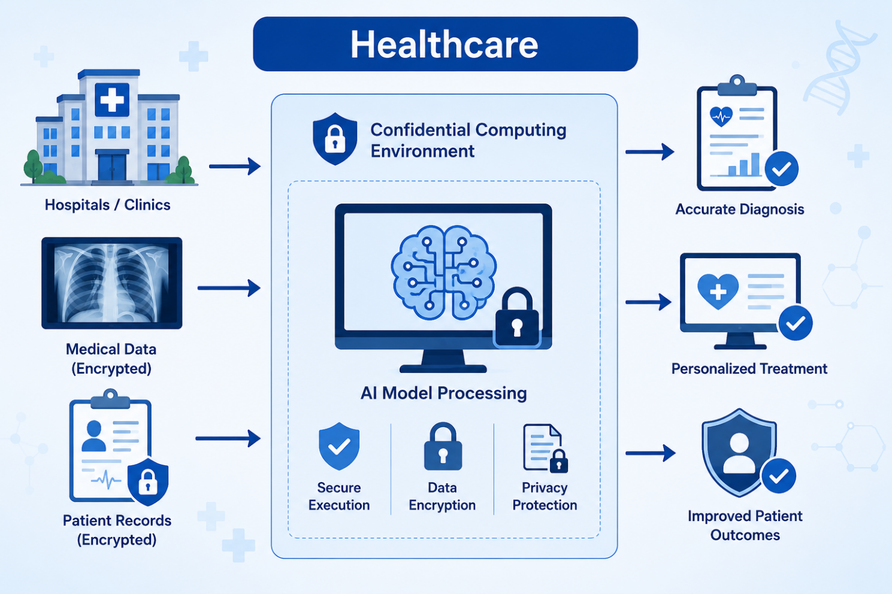
Applications
Healthcare Application of Confidential Computing
Fig(1): Secure Healthcare Application Using Confidential Computing.
Dept of MCA, VCET, Puttur.

Slide 9
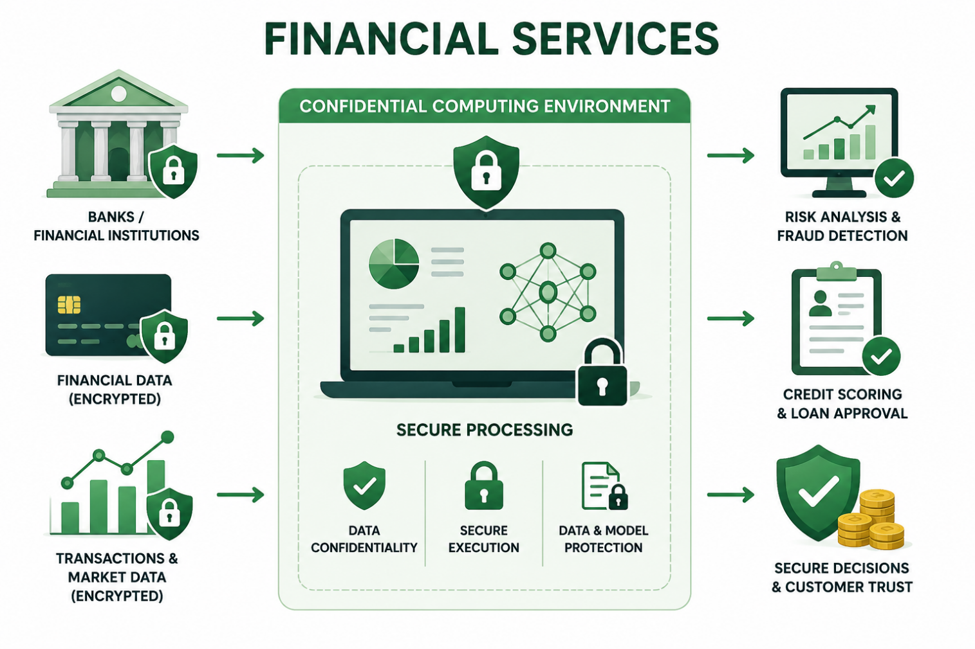
Applications
Financial Services Application of Confidential Computing
Fig(2): Secure Financial Services Using Confidential Computing
Dept of MCA, VCET, Puttur.

Slide 10
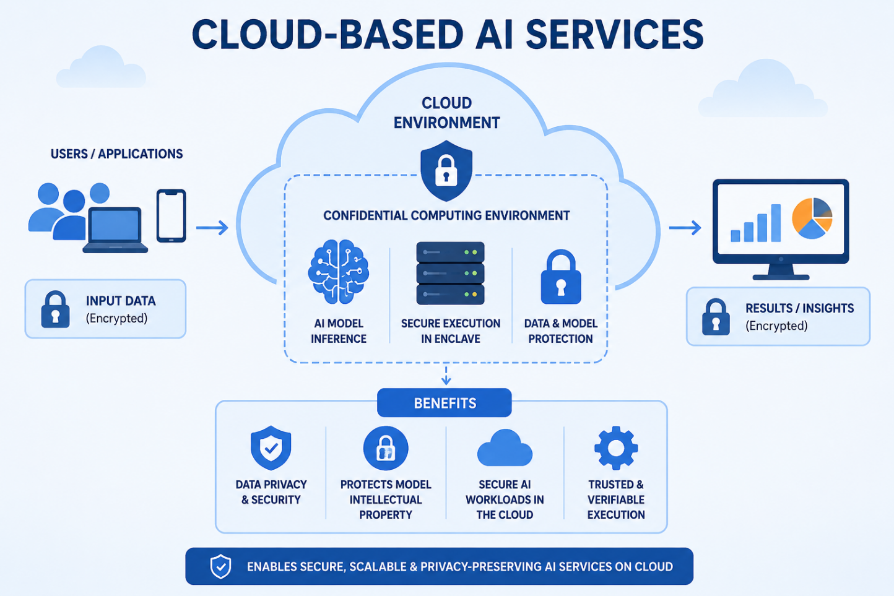
Applications
Cloud-Based AI Services Using Confidential Computing
Fig(3): Secure Cloud-Based AI Services Using Confidential Computing.
Dept of MCA, VCET, Puttur.

Slide 11
Methodology
The process begins with collecting and preparing sensitive data, such as healthcare or financial information. The data is cleaned and formatted, and then an appropriate AI model is trained based on the application requirements.
After training, the model is deployed using confidential computing technologies like Trusted Execution Environments (TEEs). The input data is encrypted and securely processed inside the TEE, ensuring that both the data and the model remain protected during execution.
Dept of MCA, VCET, Puttur.

Slide 12
Methodology
The results are generated and encrypted before being sent back to the user. The system is then evaluated to ensure that it provides strong security along with efficient performance.
Remote attestation is used to verify that the secure environment is trustworthy before processing any data. This step ensures that the system is protected from unauthorized access and maintains the integrity of the AI deployment.
Dept of MCA, VCET, Puttur.
Notes:
Bertopic: Unlike traditional topic modeling methods like Latent Dirichlet Allocation (LDA) or Non-Negative Matrix Factorization (NMF), which rely on word frequency and co-occurrence statistics, BERTopic uses state-of-the-art transformer-based language models to capture the semantic meaning of words and phrases.
ATLAS.ti is a powerful qualitative data analysis (QDA) software used by researchers to analyze complex data sets, including text, audio, video, and images. It helps in managing, coding, and interpreting qualitative data, making it easier to identify patterns, themes, and insights.

Slide 13
Conclusion
Secure deployment of AI models is essential as they handle sensitive data in many real-world applications. Confidential computing helps protect both data and models during processing using Trusted Execution Environments (TEEs).
This approach improves data privacy and prevents unauthorized access, making AI systems more secure and trustworthy. It also supports safe deployment of AI models on cloud platforms.
Confidential computing plays a key role in enabling secure AI applications in fields like healthcare, finance, and cloud services.
Dept of MCA, VCET, Puttur.

Slide 14
References
[1] P. N. Uttari and N. Thapa, “Secure AI inference in the cloud: Enabling confidential computing with trusted execution,” International Journal of Computer Technology and Electronics Communication, vol. 8, no. 3, pp. 10685–10686, 2025.
[2] D. D. Agarwal and A. K. Cherukuri, “Confidential computing for cloud security: exploring hardware-based encryption using trusted execution environments,” Vellore Institute of Technology, School of Computer Science Engineering and Information Systems, 2024.
[3] M. U. Sardar and C. Fetzer, “Confidential computing and related technologies: A critical review,” Cybersecurity, vol. 6, 2023.
Dept of MCA, VCET, Puttur.

Slide 15
Thank you
Dept of MCA, VCET, Puttur.

